Slide 1
LAYERS OF KERAS (BASIC)
0. MODEL SUMMARY / VISUALIZE
0. Tensors
1. DENSE LAYER /
Initializer
Regularizers
Constraints
2. ACTIVATION LAYER / FUNCTIONAL
EXAMPLE 1 - CODE REVIEW
EXAMPLE 2 – CONCEPT REVIEW
3. DROPOUT LAYER
- MLP (Dense + Dropout)
4. LAMBDA LAYER / MERGING
5. NEXT – CONVOLUTION LAYERS

Slide 2

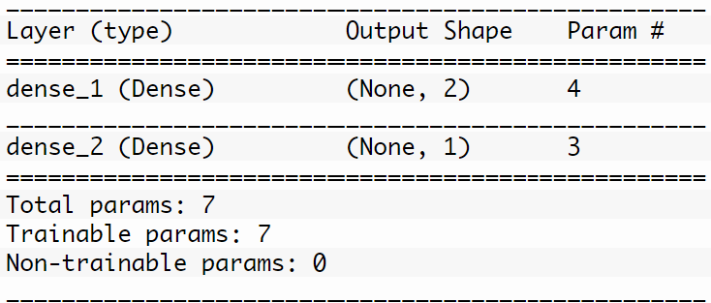
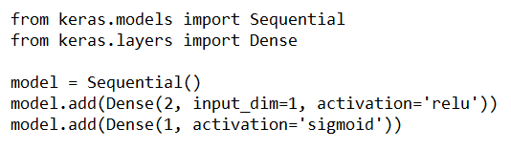
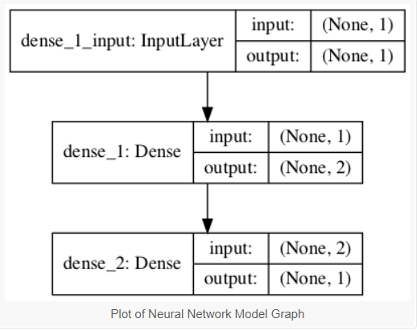

MODEL SUMMARY / VISUALIZE
Neurons VEIW
Model Summary
Model GRAPH
WHY USE??
Confirm order of layer
Confirm in/output of each layer
Confirm parameters

Slide 3
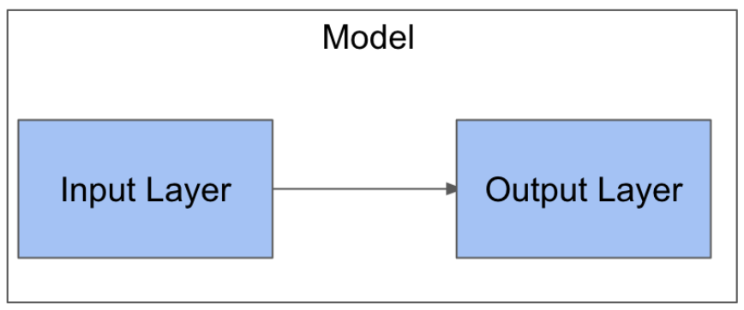
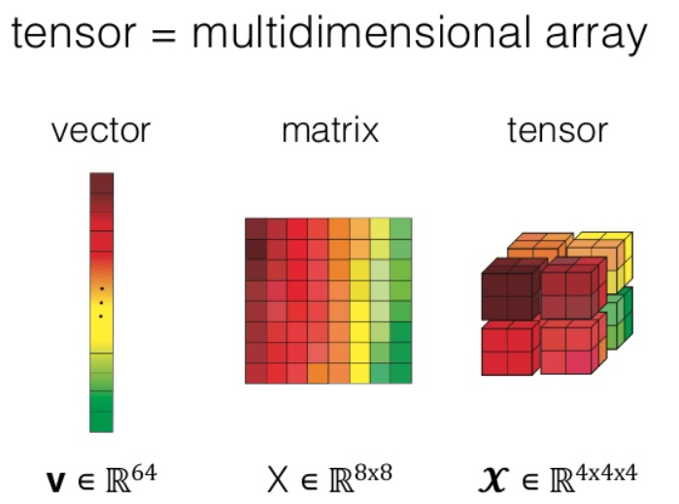
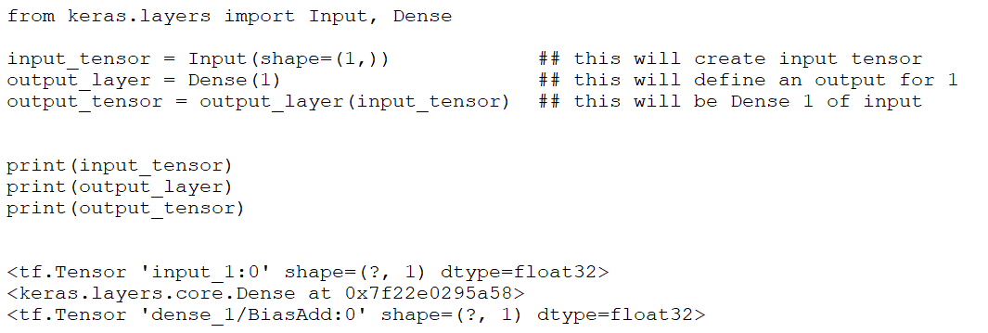

Input, dense, output
Input has to convert into Tensor
*Dense is Functional Layer
Output is Tensor
Input shape is tuple
shape is table (R,C) where C=Columns which are variables

Slide 4
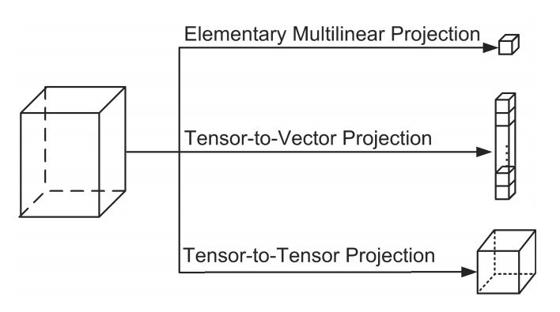
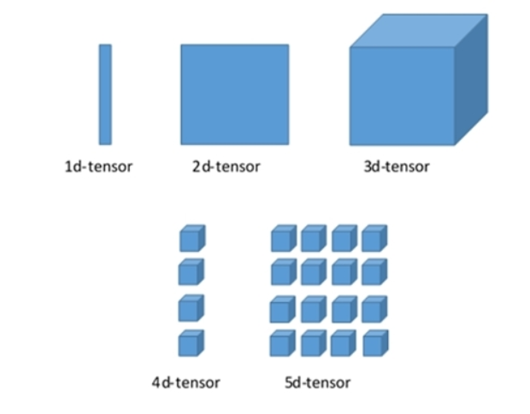
TESNORs
VECTOR – ARRAY (1D with Dimension)
MARTIX – Row x Col
Tensor – Multi-Dimensional (super Matrix)

Slide 5
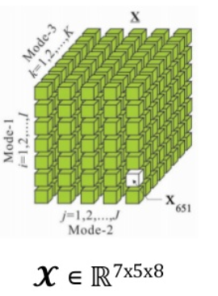
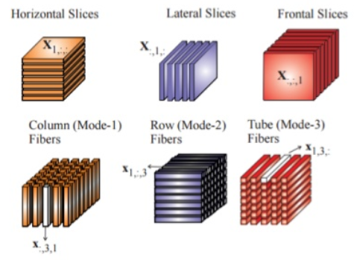
TESNORs (3rd orders / slicing)
Horizontal Column Mode-1 Fiber
Lateral Column Mode-2 Fiber
Frontal Column Mode-3 Fiber

Slide 6
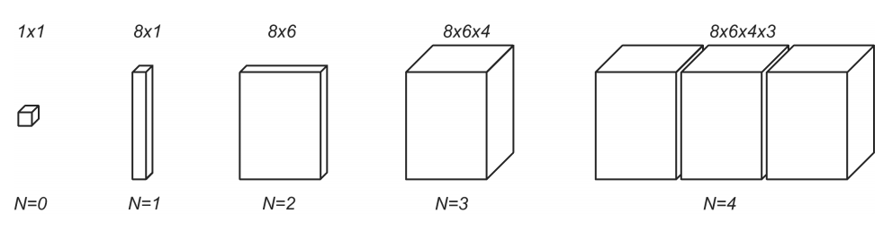
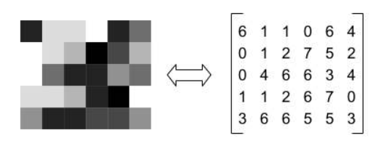
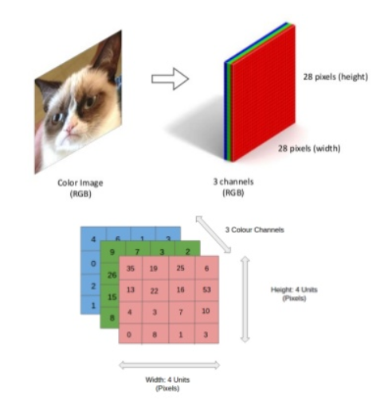
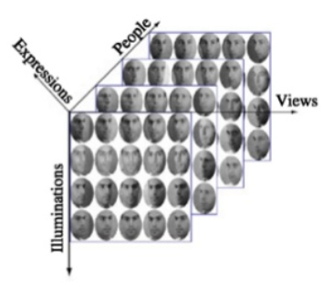
TESNORs (3rd orders / slicing) – example
Grayscale 2nd Order (RxC)
Color 3rd Layer (RxC x color 28x28x3)
Facial Expression 4th Order – (PxIxVxE)

Slide 7
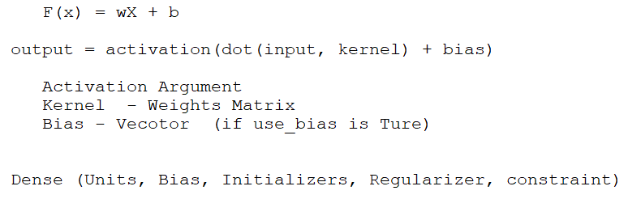
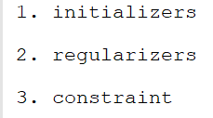
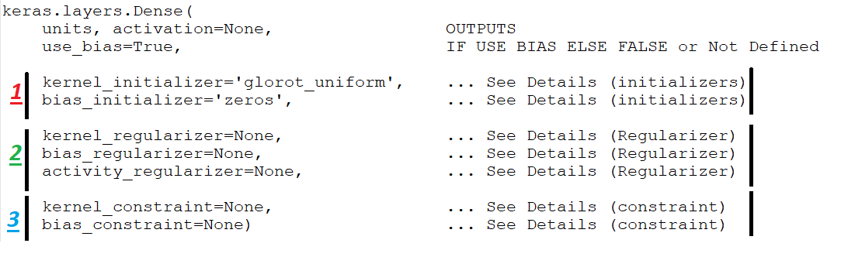
DENSE LAYER (MLP)
to set the initial random weights of layers.

Slide 8

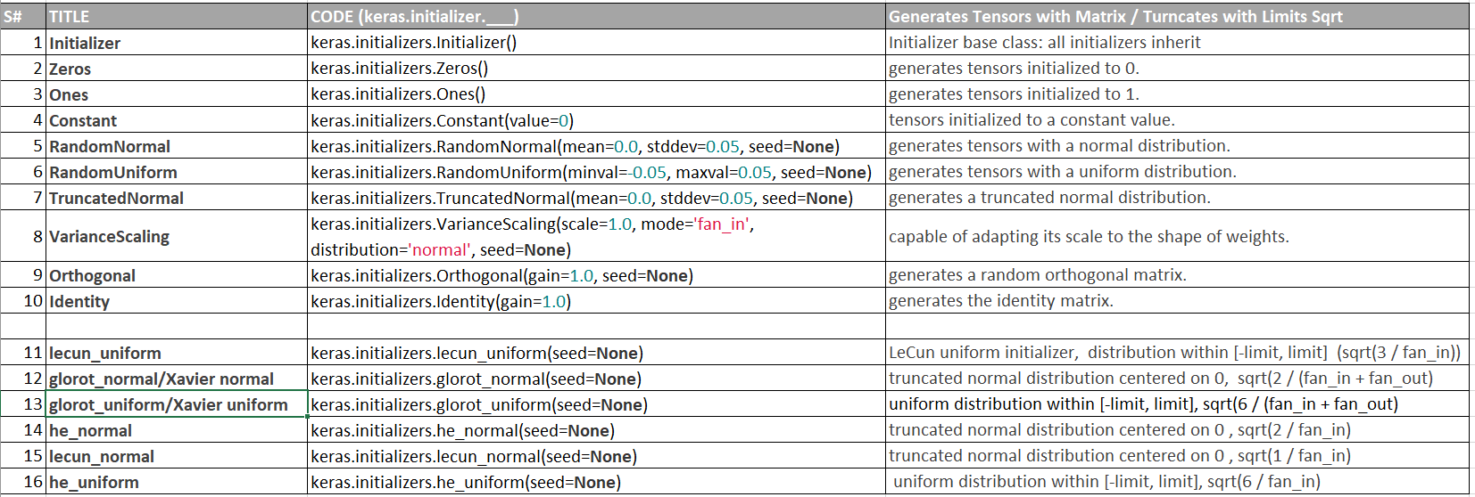
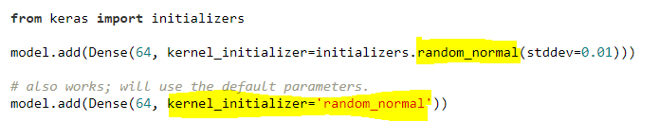
1. initializers
way to set the initial random weights of Keras layers.
passing initializers to layers will depend on the layer.

Slide 9
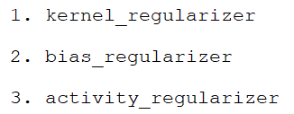
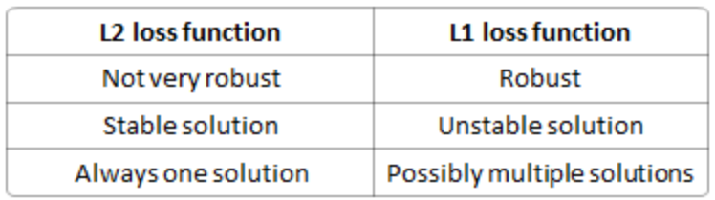
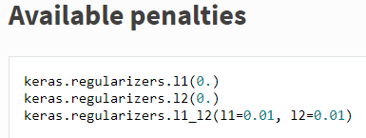
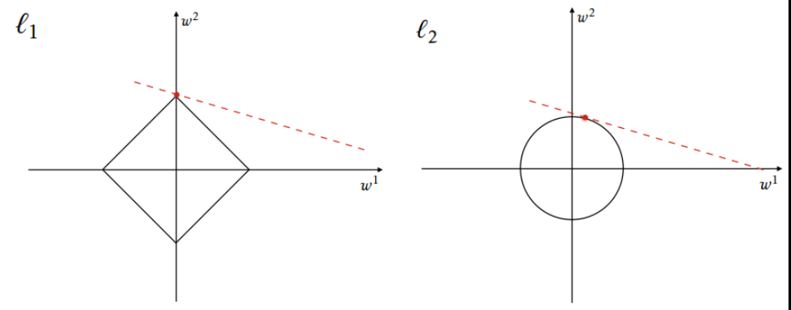

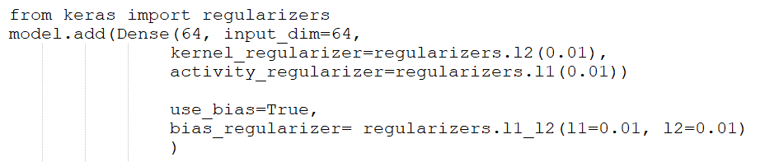
2. REGULARIZER (L1, L2, L1_L2)
to apply penalties on layer parameters or layer activity during optimization.
penalties are incorporated in the loss function
applied on a per-layer basis

Slide 10
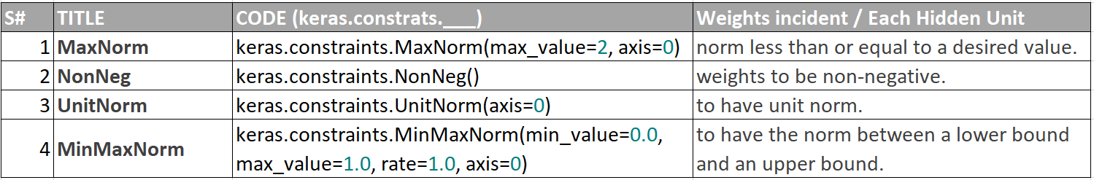
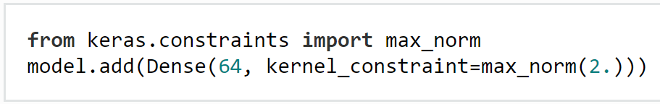
3. CONSTRAINTS
allow setting constraints (eg. non-negativity) on network parameters during optimization
penalties are applied on a per-layer basis.

Slide 11


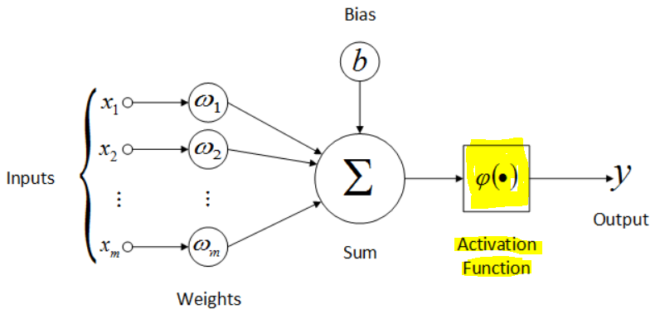
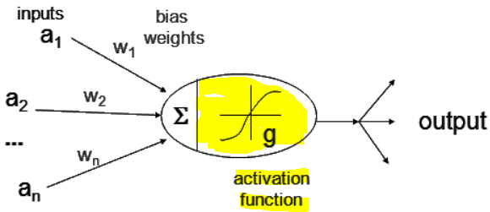
ACTIVATION LAYER
without Activation function would simply be a Linear regression Model
Their main purpose is to convert a input signal of a node in a A-NN to an output signal
Can be added or could be sub-part or layer
Applies an activation function to an output.
==
==

Slide 12
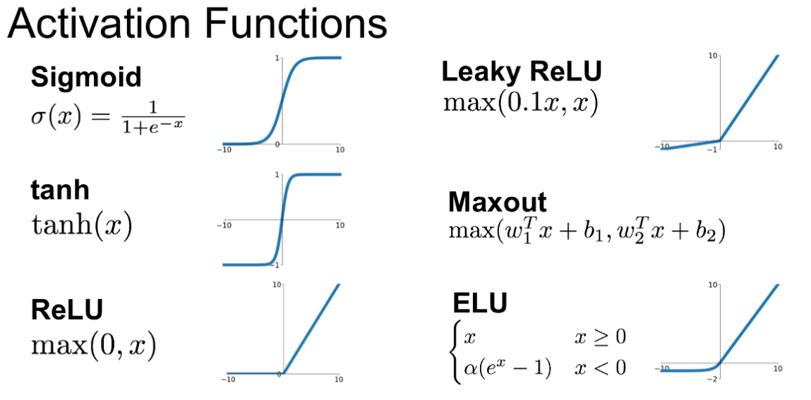
ACTIVATION LAYER (Details later)
If No Activation → a simple linear function (not effective)
ACTIVATIONS → introduce non-linear properties to our Network

Slide 13
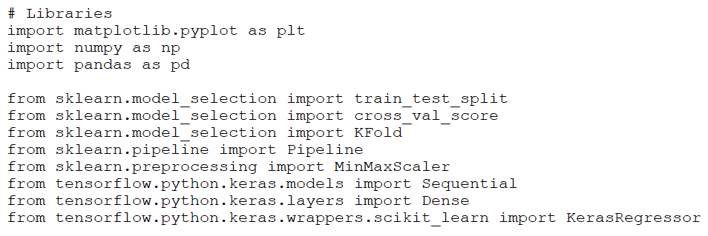
EXAMPLE : Dense layer
(linear Regression)
to predict the value of a potential car sale (i.e. how much a particular person will spend on buying a car) for a customer based on the following attributes:
Age, Gender, Average miles per day, Personal debt, Monthly income (5 Columns)
Construct neural networks with Keras
Scale data appropriately with MinMaxScaler
Calculate training and test losses
Make predictions using the neural network model

Slide 14
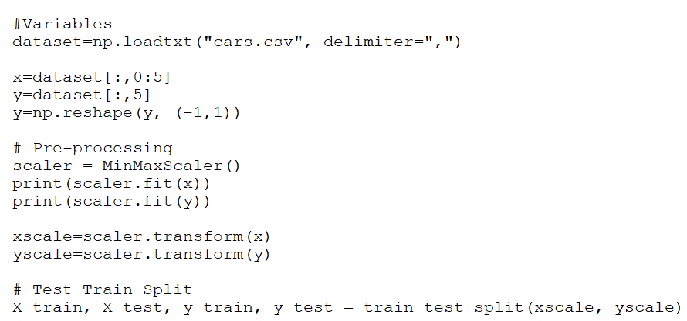
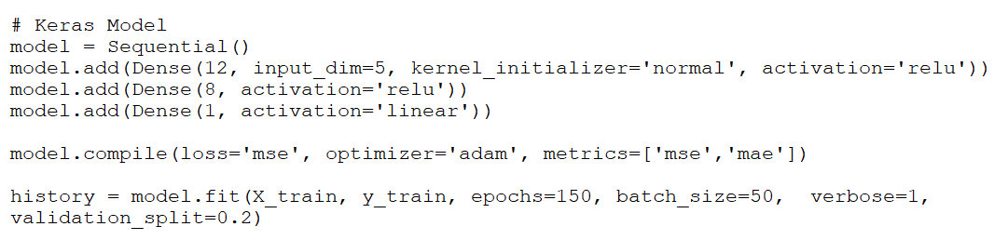
1.
2.

Slide 15
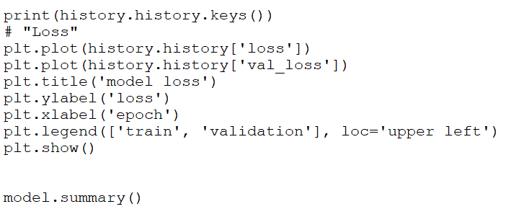
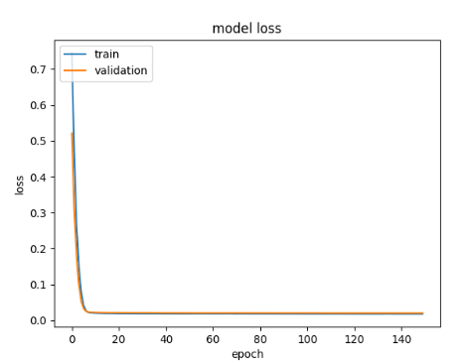
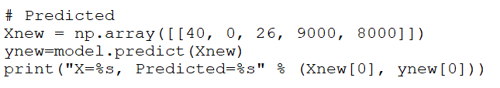
3.
4.

Slide 16
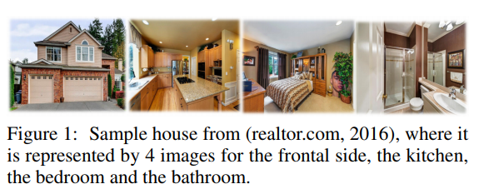
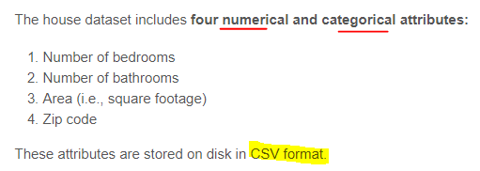
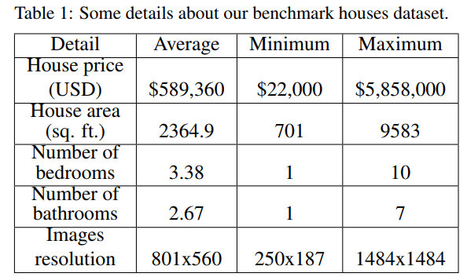
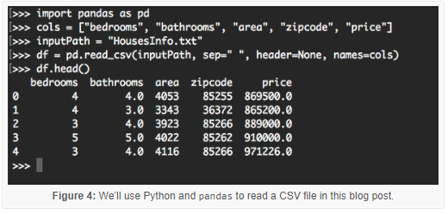
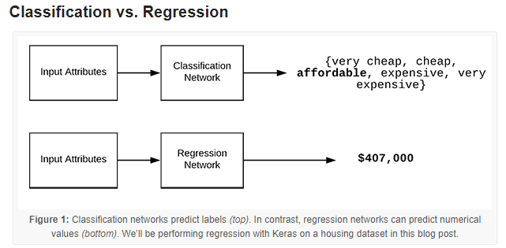
EXAMPLE 2: dense layer (review)
353 Images (Dataset CSV)
Keras and regression to predict the price of houses

Slide 17
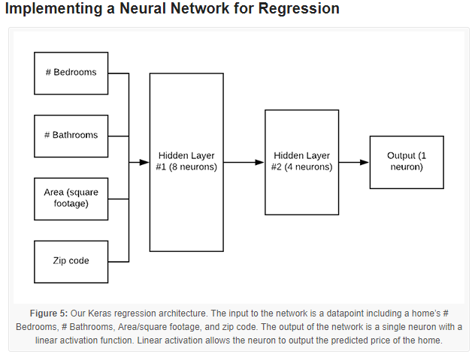
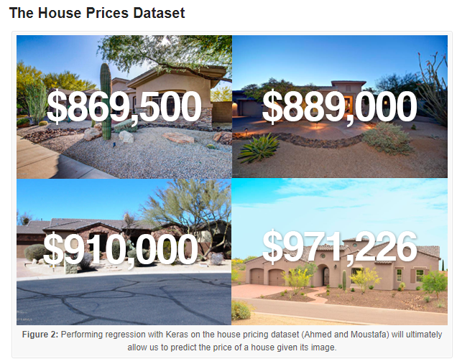
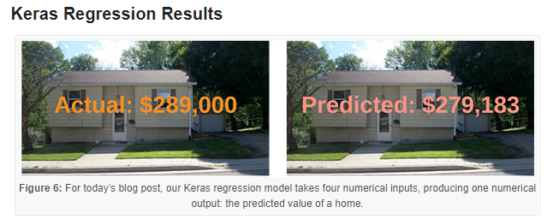
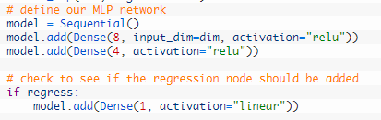

Slide 18
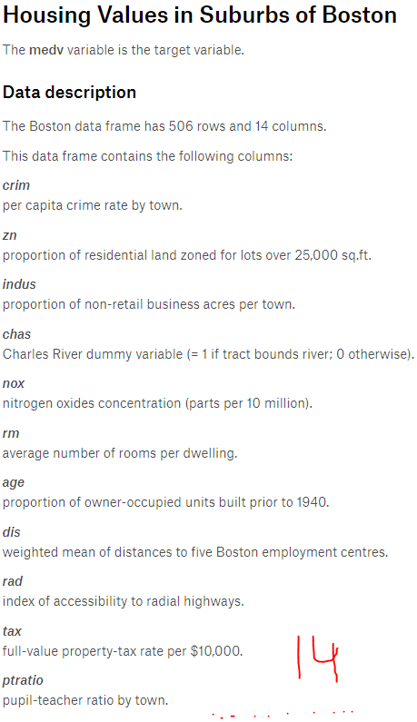
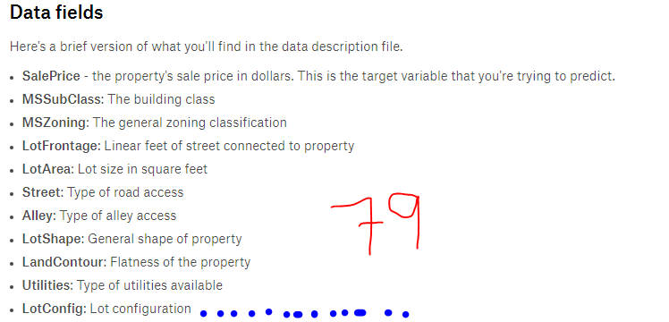
14. the Boston House Prices Dataset includes a total of 14 attributes which can be leveraged for house price prediction (although that dataset does have some racial discrimination).
79. The Ames House Dataset includes over 79 attributes which can be used to train regression models.
https://www.pyimagesearch.com/2019/01/21/regression-with-keras/

Slide 19
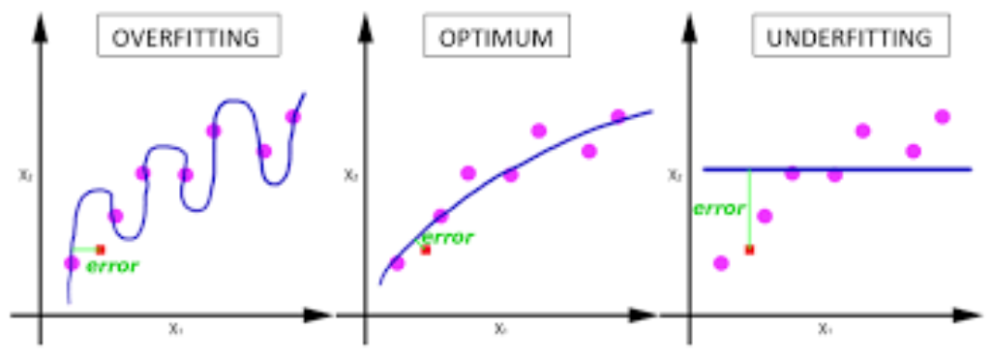
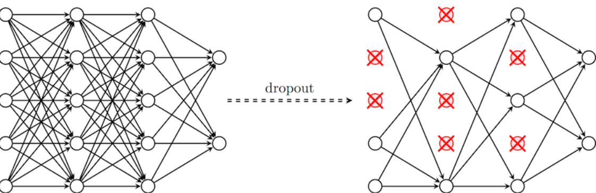
DROPOUT LAYER
Applies Dropout to the input.
(reduce FULLY INTERCONNECTION)
Fraction of the input units to drop (as PERCENTAGE)
It Reduces OVERFITTING
dropout rate of 0.2 (set 20% of inputs to zero).

Slide 20
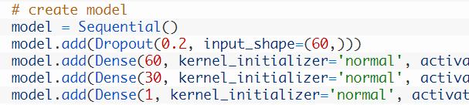
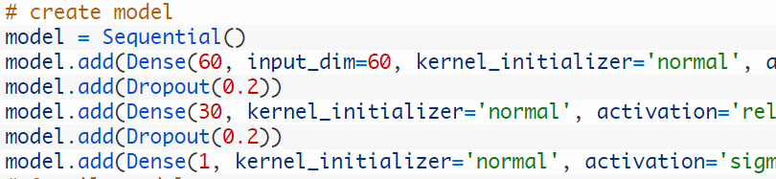
DROPOUT - ON VISIBLE LAYER
Dropout can be applied to input neurons called the visible layer.
The dropout rate is set to 20%,
meaning one in 5 inputs will be randomly
excluded from each update cycle
DROPOUT - ON HIDDEN LAYER
Dropout can be applied to hidden neurons
in the body of your network model.
Dropout is applied between the two hidden layers and between the last hidden layer and the output layer. Again a dropout rate of 20% is used as is a weight constraint on those layers.

Slide 21
WHEN TO USE DROPOUT
INCREASE LEARNING RATE / REDUCE OVERFITTING / GOOD RESULTS
Use a small dropout value of 20%-50% of neurons with 20% providing a good starting point. A probability too low has minimal effect and a value too high results in under-learning by the network.
Use a larger network. You are likely to get better performance when dropout is used on a larger network, giving the model more of an opportunity to learn independent representations
Use dropout on incoming (visible) as well as hidden units. Application of dropout at each layer of the network has shown good results.
Use a large learning rate with decay and a large momentum. Increase your learning rate by a factor of 10 to 100 and use a high momentum value of 0.9 or 0.99.
Constrain the size of network weights. A large learning rate can result in very large network weights. Imposing a constraint on the size of network weights such as max-norm regularization with a size of 4 or 5 has been shown to improve results.

Slide 22

KERAS – MLP (Dense +dropout)
LIBRARY
TRAIN ds
TEST ds
MODEL
COMPILE
FIT/TRAIN
SCORE
PREDICT

Slide 23

KERAS – MLP
"epoch" serves as a reference point from which time is measured.
Unix timestamp term
Total STEPS
Loss & Accuracy per STEP
Total 30 Random Numbers
Prediction Binary as 0 and 1
(rounded fraction)

Slide 24
NEXT – MORE LAYERS (IMAGES)
- CONVOLUTION
- POOLING
- FLATTEN
- LAMBDA

Slide 25



LAMDA LAYER/ FUNCTIONS

Slide 26



MERGING BY LAMDA function

